Slide 1
File-System Implementation
File-System Structure
Allocation Methods
Free-Space Management

Slide 2
File-System Structure
File structure
Logical storage unit
Collection of related information
File system resides on secondary storage (disks).
File system organized into layers.
File control block – storage structure consisting of information about a file.

Slide 3
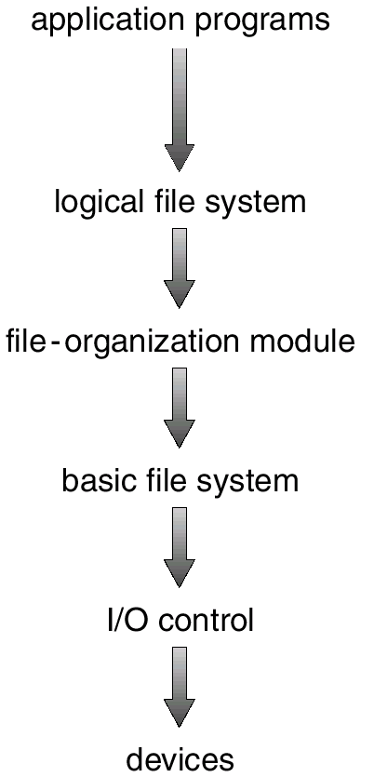
Layered File System
Calls the logical file system eg to create a file
Uses directory structure
Responsible for protection and security
Free space management,
Knows about files and their logical blocks and physical blocks
Issue generic cmds
Device drivers an interrupt handlers

Slide 4
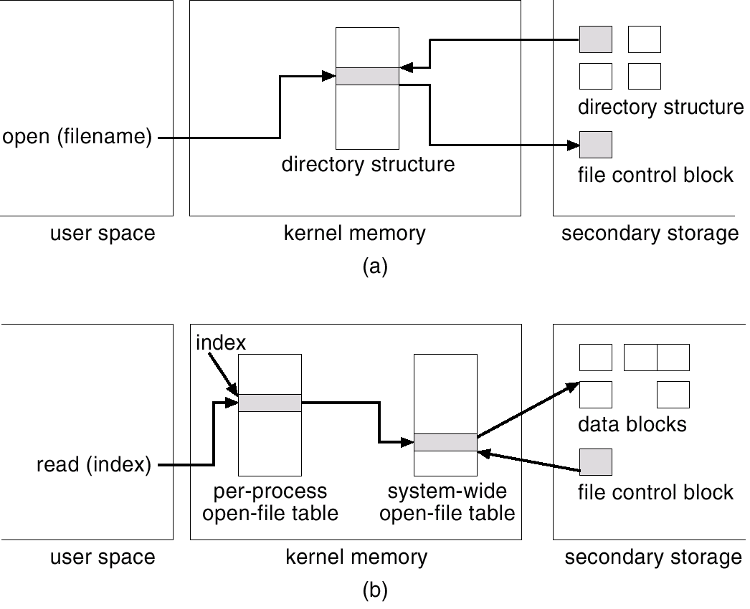
In-Memory File System Structures

Slide 5
Allocation Methods
An allocation method refers to how disk blocks are allocated for files:
Contiguous allocation
Linked allocation
Indexed allocation

Slide 6
Contiguous Allocation
Each file occupies a set of contiguous blocks on the disk.
Simple – only starting location (block #) and length (number of blocks) are required.
Random access.
Wasteful of space (dynamic storage-allocation problem).
Files cannot grow.

Slide 7
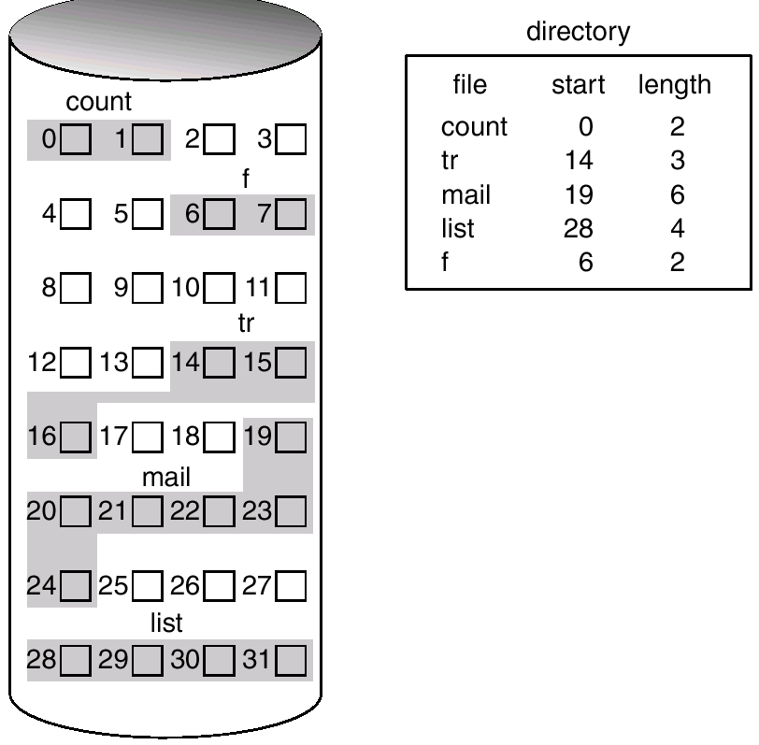
Contiguous Allocation of Disk Space

Slide 8
Extent-Based Systems
Many newer file systems (I.e. Veritas File System) use a modified contiguous allocation scheme.
Extent-based file systems allocate disk blocks in extents.
An extent is a contiguous block of disks. Extents are allocated for file allocation. A file consists of one or more extents.
Suffers from internal fragmentation if extent size is large
Suffers from external fragmentation if extent size is variable

Slide 9
Linked Allocation
Each file is a linked list of disk blocks: blocks may be scattered anywhere on the disk.
block =
pointer

Slide 10
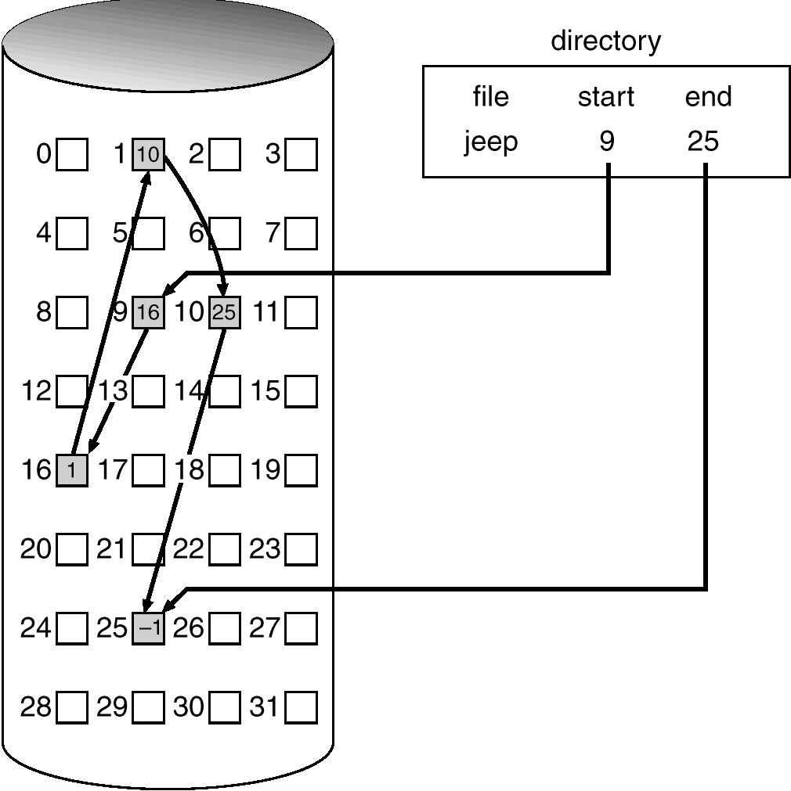
Allocate as needed, link together; e.g., file starts at block 9

Slide 11
Linked Allocation (Cont.)
Simple – need only starting address
Free-space management system – no waste of space
No random access
Size of the file need not be declared at the time of creation
No external fragmentation
No compaction required
The file can be extended as long as free holes are available

Slide 12
Linked Allocation (Cont.)
Disadvantages
Effective on sequential access
Space required for the pointer is waste
Reliability is a problem because of pointers because pointer damaged or lost.

Slide 13
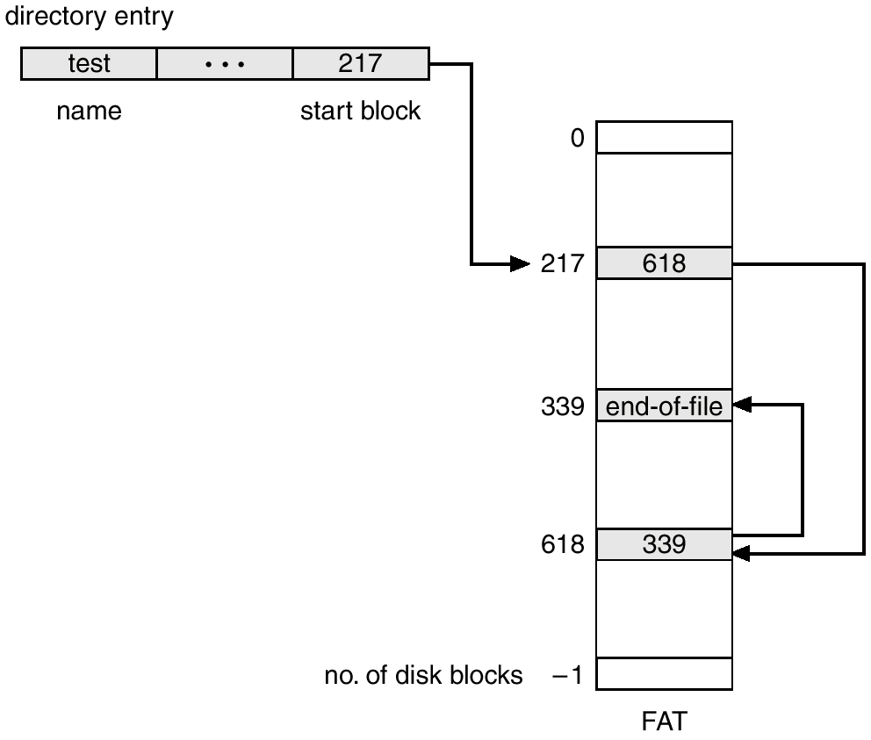
File-Allocation Table
Variation of linked allocation
It is stored in beginning f volume
Table has one entry for each block

Slide 14
Indexed Allocation
Brings all pointers together into the index block.
Logical view.
index table

Slide 15
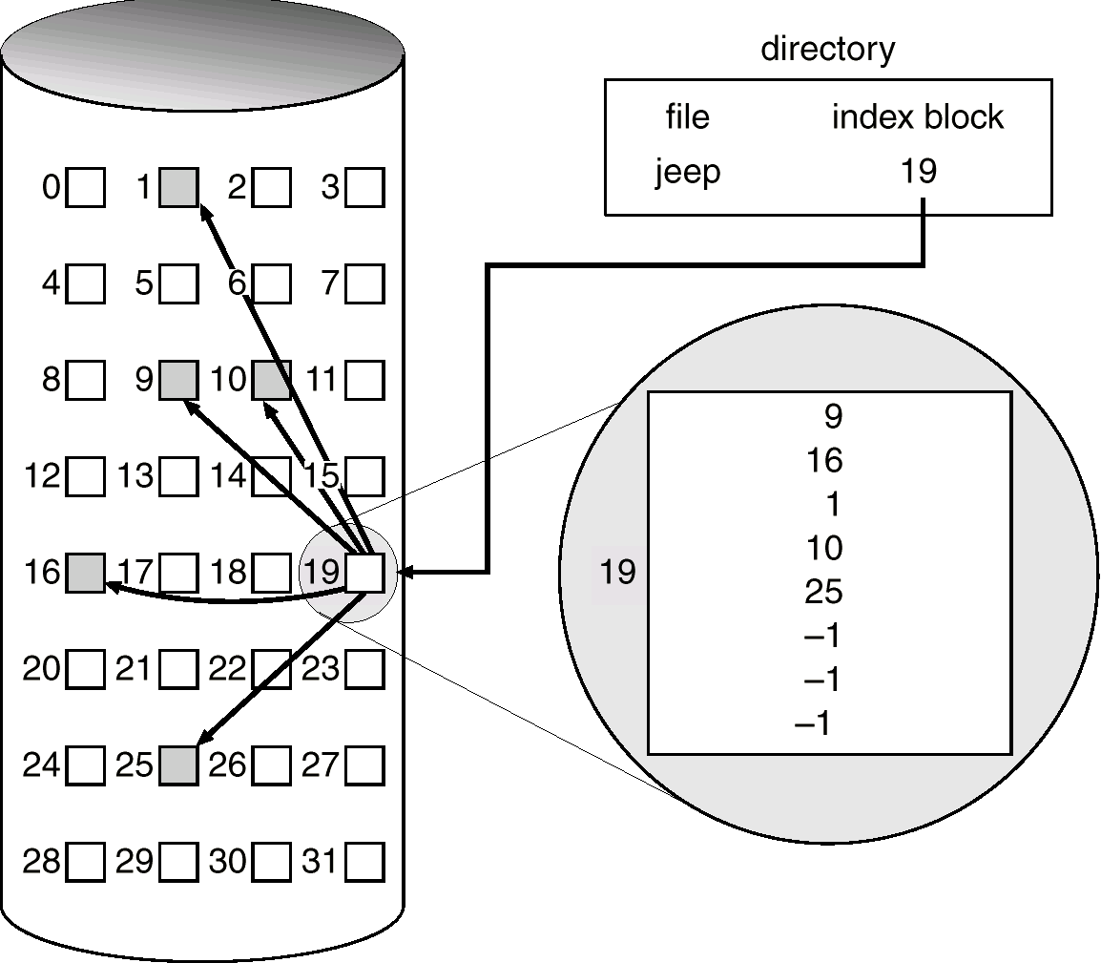
Example of Indexed Allocation

Slide 16
Indexed Allocation (Cont.)
Need index table
Random access
Dynamic access without external fragmentation, but have overhead of index block.

Slide 17
Free-Space Management
Bit vector or bit amp (n blocks)
0
1
2
n-1
…
1 ⇒ block[i] free
0 ⇒ block[i] occupied
bit[i] =

For example, consider a disk where blocks 2, 3, 4, 5, 8, 9, 10, 11,
12, 13, 17, 18,25,26, and 27 are free ard the rest of the blocks are
allocated. The free-space bit map would be
001111001111110001100000011100000…….

Slide 18
Free-Space Management (Cont.)
Bit map requires extra space. Example:
block size = 2¹² bytes
disk size = 2³⁰ bytes (1 gigabyte)
n = 2³⁰/2¹² = 2¹⁸ bits (or 32K bytes)
Easy to get contiguous files

Slide 19
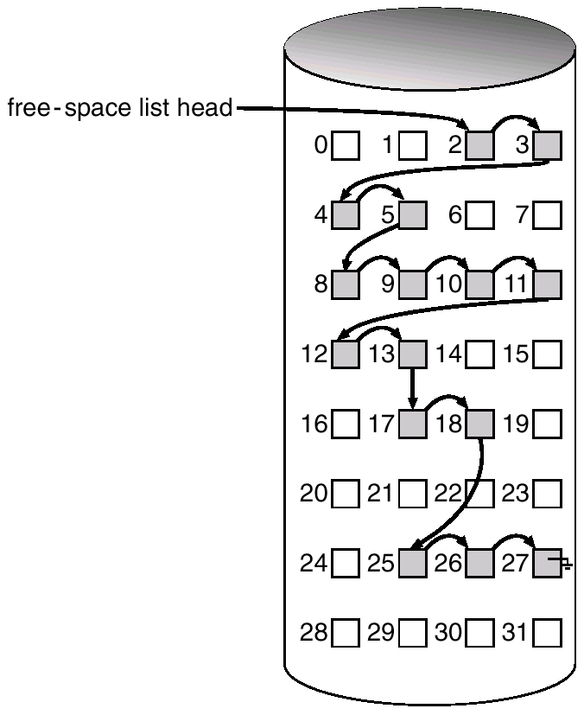
Linked Free Space List on Disk
Linked list (free list)
Cannot get contiguous space easily
Less waste of space compared to bit map

Slide 20
Grouping
is to store the addresses of n free blocks in the first free block. The first n~1 of these blocks are actually free.
The last block contains the addresses of another free blocks, and so on.
The addresses of a large number of free blocks can now be found quickly, unlike the situation when the standard linked-list approach is used.

Slide 21
Counting
rather than keeping a list of free disk addresses, we can keep the address of the first free block and the number of free contiguous blocks that follow the first block.
Each entry in the free-space list then consists of a disk address and a count.
Although each entry requires more space than would a simple disk address, the overall list will be shorter, as long as the count is generally greater than 1.

